Slide 1

DevOps

Slide 2
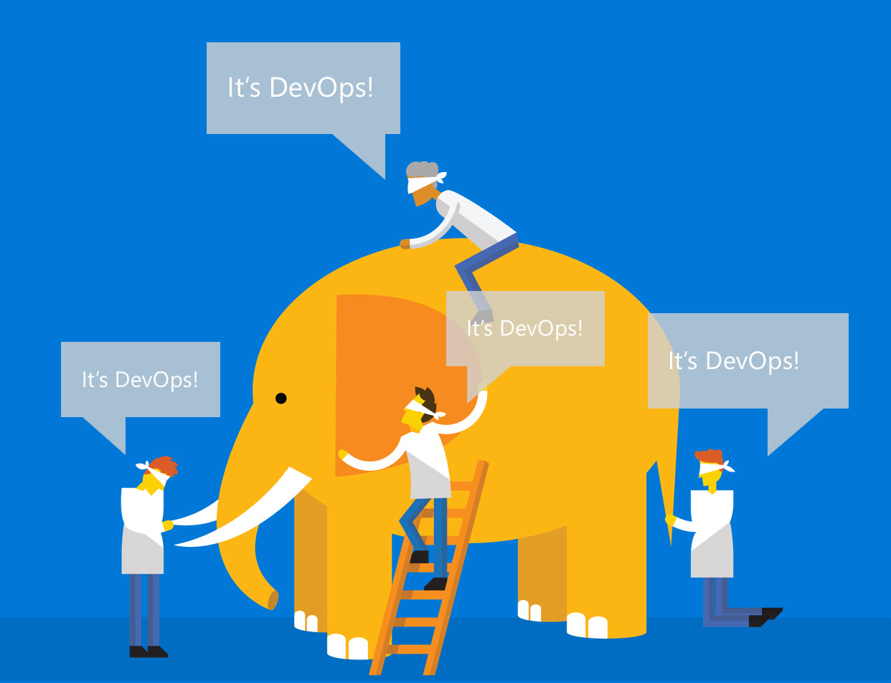

Slide 3
People
Culture
Process
DevOps
skills
Agility
Technology

Slide 4
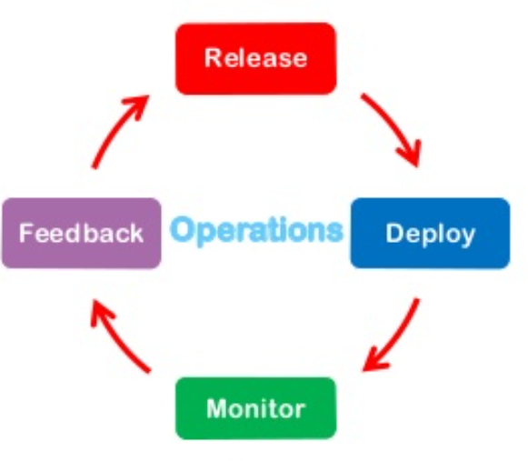
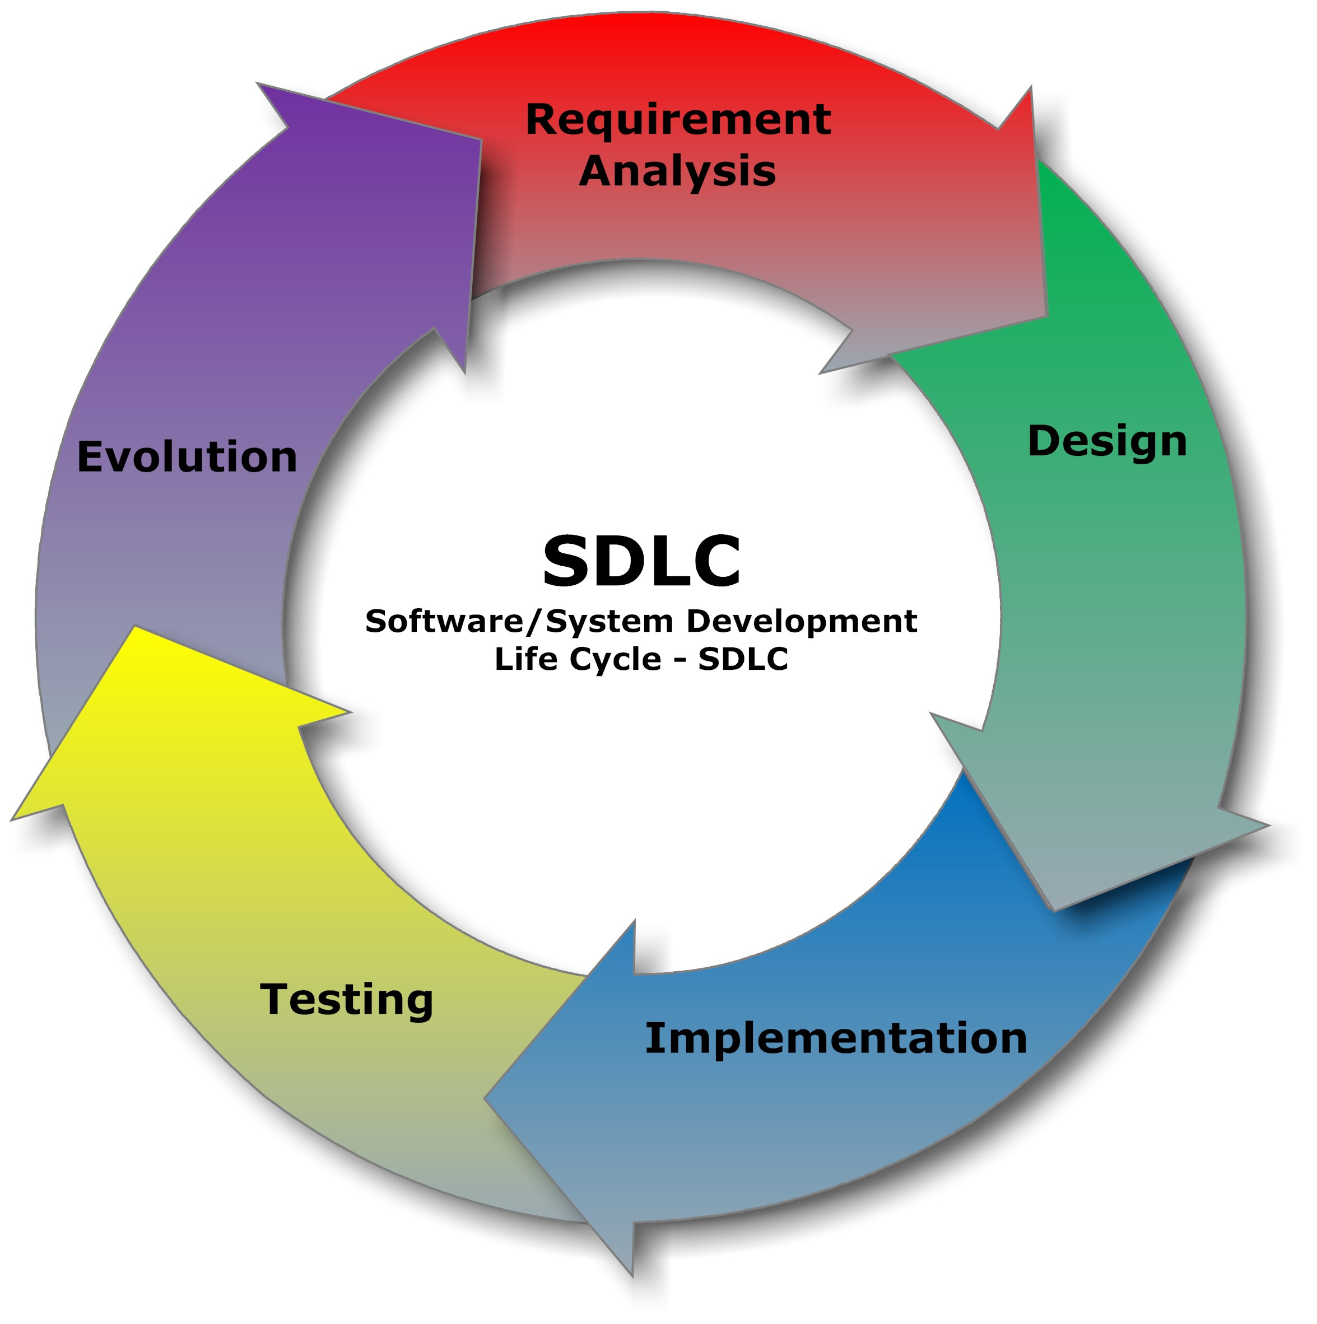

Slide 5
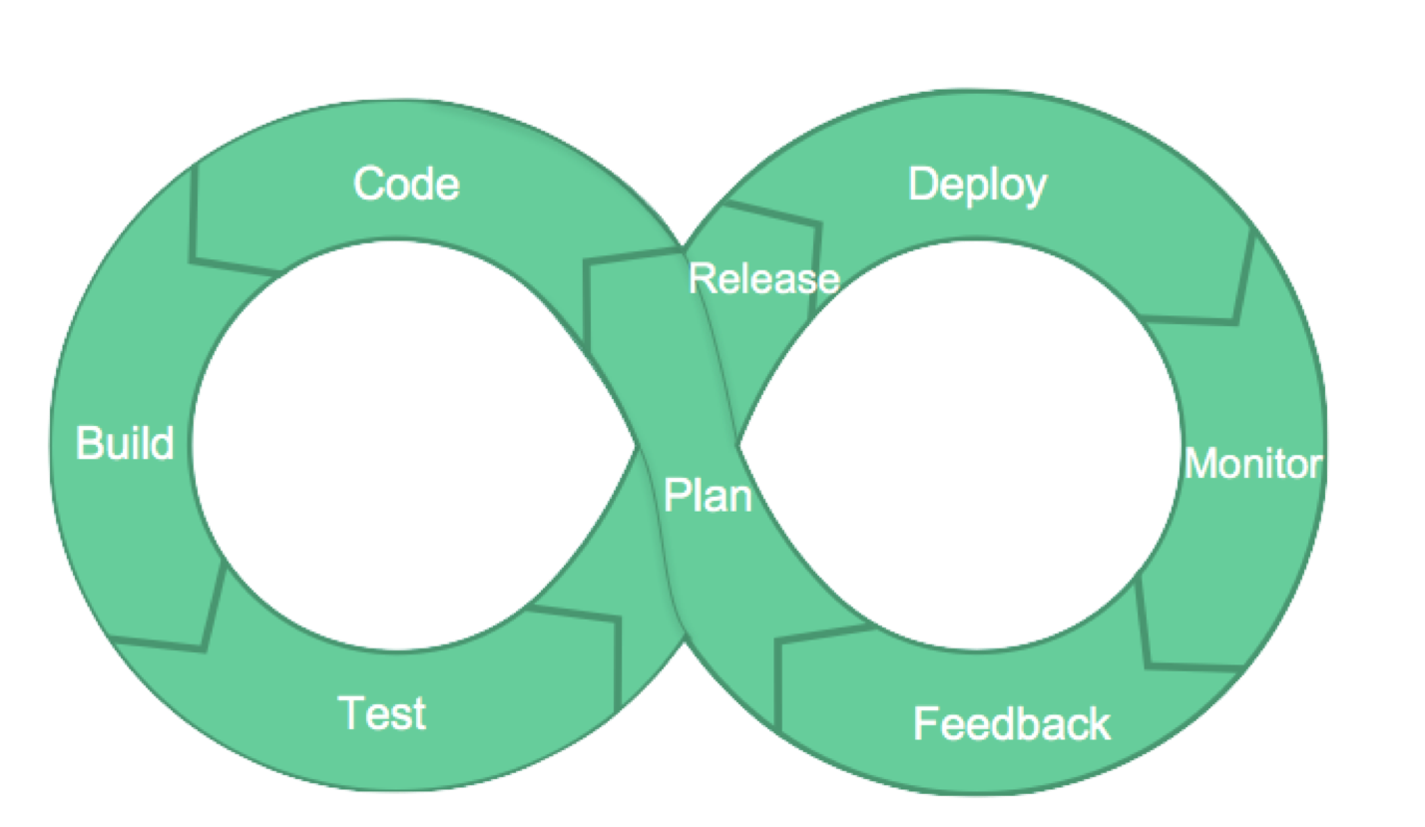

Slide 6

“DevOps is development and operations collaboration”
“DevOps is treating your infrastructure as code”
It’s DevOps!
“DevOps is using automation”
It’s DevOps!
It’s DevOps!
“DevOps is feature switches”
It’s DevOps!
“DevOps is small deployments”
“Kanban for Ops?”

Slide 7
What is DevOps
DevOps is a set of practices
bringing both Developers and Operations team together from start of the project/product
for faster, quicker and efficient end-to-end delivery of software products and services
to end customer again and again
reducing time to market thereby gaining competitive advantage

Slide 8

Why am I not getting desired results from my team
How do I achieve faster time to market ?
How I can keep my production servers secure and stable with frequent releases
How can I ensure that everything in my system is running well?

Slide 9
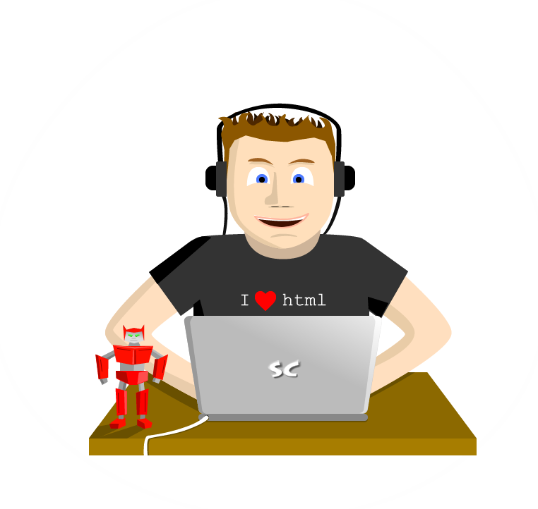



Business
Revenue growth
Well designed and structured code
Stable and Secure deployments

Slide 10


Traditional Development and Operations
DEV
OPS
Notes:
Taken from: http://dev2ops.org/2010/02/what-is-devops/
Development kicks things off by “tossing” a software release “over the wall” to Operations. Operations picks up the release artifacts and begins preparing for their deployment. Operations manually hacks the deployment scripts provided by the developers or creates their own scripts. They also hand edit configuration files to reflect the production environment, which is significantly different than the Development or QA environments. At best they are duplicating work that was already done in previous environments, at worst they are about to introduce or uncover new bugs.
Operations then embarks on what they understand to be the currently correct deployment process, which at this point is essentially being performed for the first time due to the script, configuration, process, and environment differences between Development and Operations. Of course, somewhere along the way a problem occurs and the developers are called in to help troubleshoot. Operations claims that Development gave them faulty artifacts. Developers respond by pointing out that it worked just fine in their environments, so it must be the case that Operations did something wrong. Developers are having a difficult time even diagnosing the problem because the configuration, file locations, and procedure used to get into this state is different then what they expect (if security policies even allow them to access the production servers!).
Time is running out on the change window and, of course, there isn’t a reliable way to roll the environment back to a previously known good state. So what should have been an eventless deployment ended up being an all-hands-on-deck fire drill where a lot of trial and error finally hacked the production environment into a usable state.

Slide 11

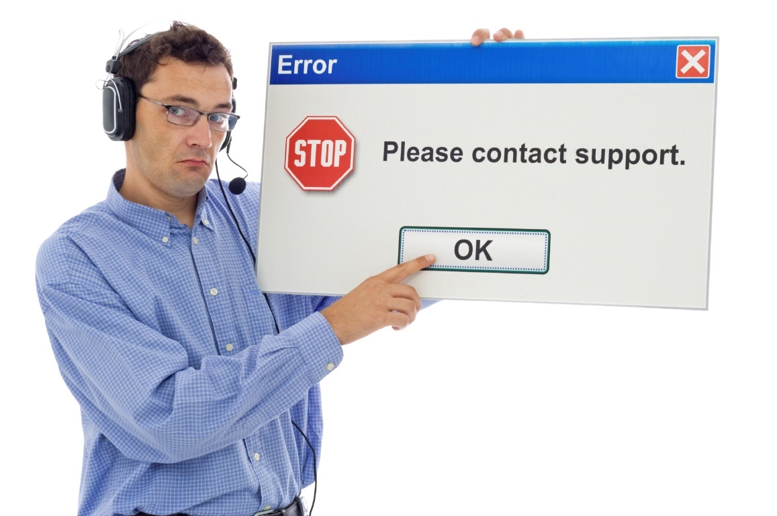

Resolving issues without DevOps
There is no problem with my code, you’re either deploying wrong or there is a problem with your infrastructure.
Infrastructure looks good, must be a code problem.
Customer finds problem with your application.
Operations gets notified of application problem.
DEV
OPS
Notes:
Pager image: http://www.medicoland.eu/ru/pager&page=4

Slide 12
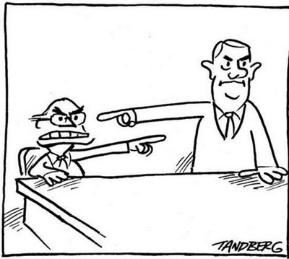
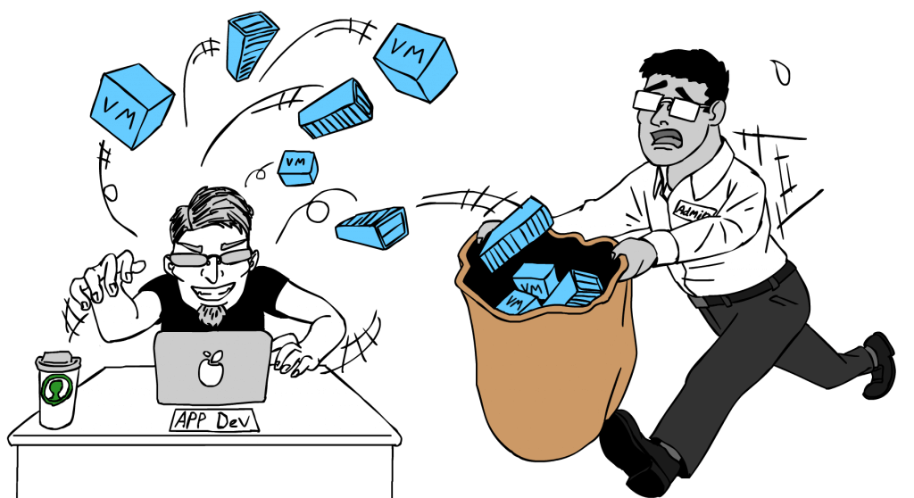
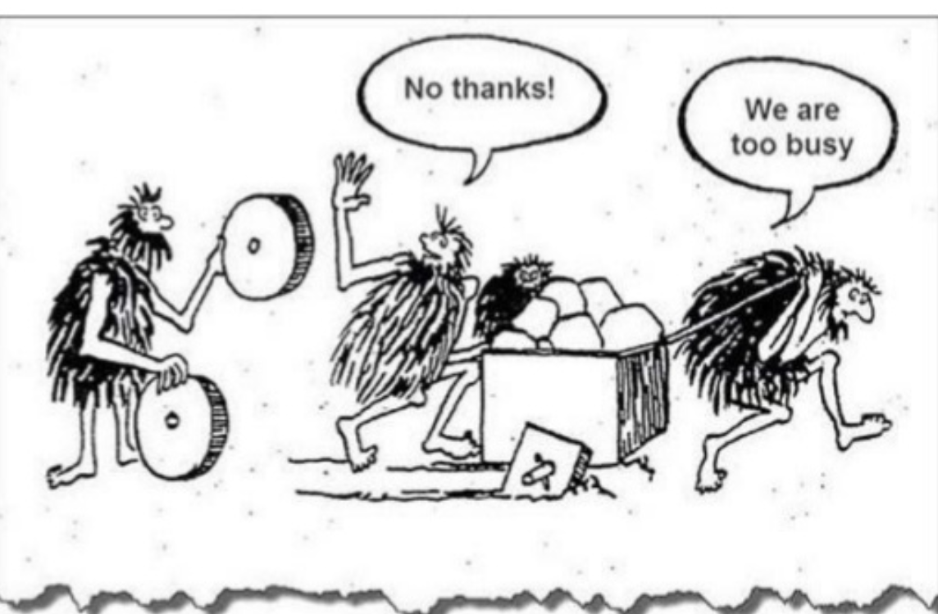
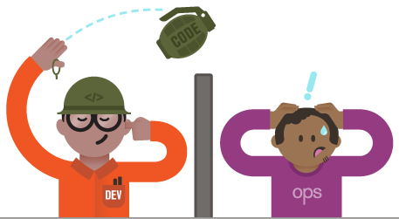
Blame Game
Speed difference between Dev and Ops
No time for innovation
Unpredictable

Slide 13
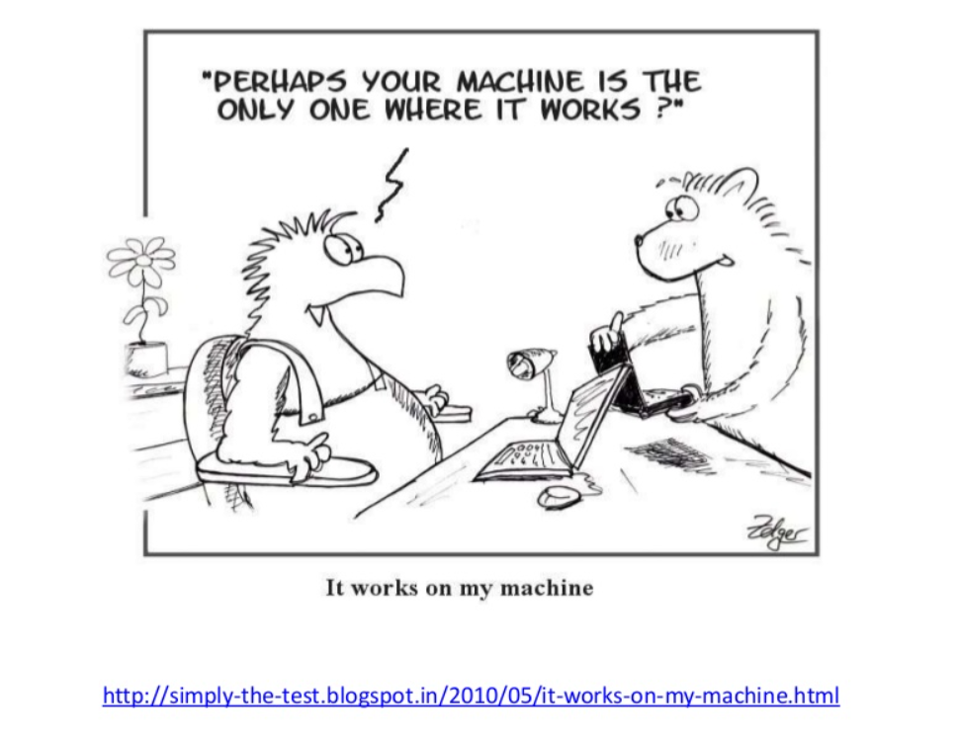

Slide 14


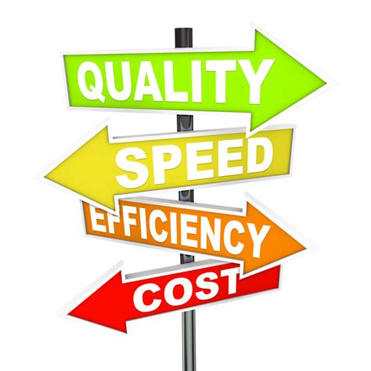

Collaboration/feedback
Active Monitoring

Slide 15

ALM framework
Plan
Operate + learn
Requirements
Development
Collaboration
Production
Develop + test
Release
Notes:
Modern application lifecycle management practices enable teams to support a continuous delivery cadence that balances agility and quality, while removing the traditional silos separating developers from operations and business stakeholders. This improves communication and collaboration within development teams, and drives connections between application and business outcomes. We see three key metrics that are critical to an organization’s ability to enable value delivery with agility and quality. First, the flow of business value must be measured and improved. Understanding what provides business value, and delivering those features on a sustained, regular cadence is key. The second is having the ability to identify and remove bottlenecks to shorten cycle times for delivering those business values. It’s not enough to simply deliver regularly, but also efficiently. And finally, identify and reduce sources of rework, such as bugs, incorrectly specified features, etc.

Slide 16
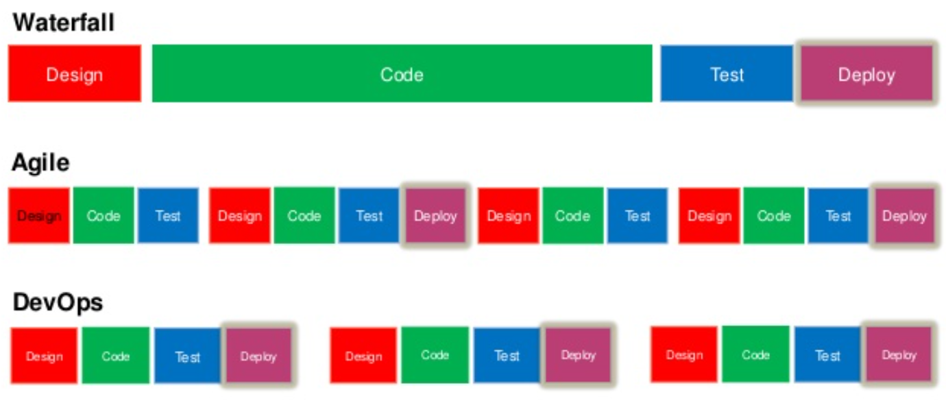

Slide 17
Continuous Integration
Automated Build
Automated Testing
Auto Environment Provisioning
Configuration Management
Continuous Deployment
Continuous Delivery
Infrastructure as code
Audit and compliance
Automated deployment
Automated Deployment
Frequent Deployment
Deploy to any environment
Deploy to production
Automated deployment
Frequent delivery
Fail fast and early
Application Configuration

Slide 18
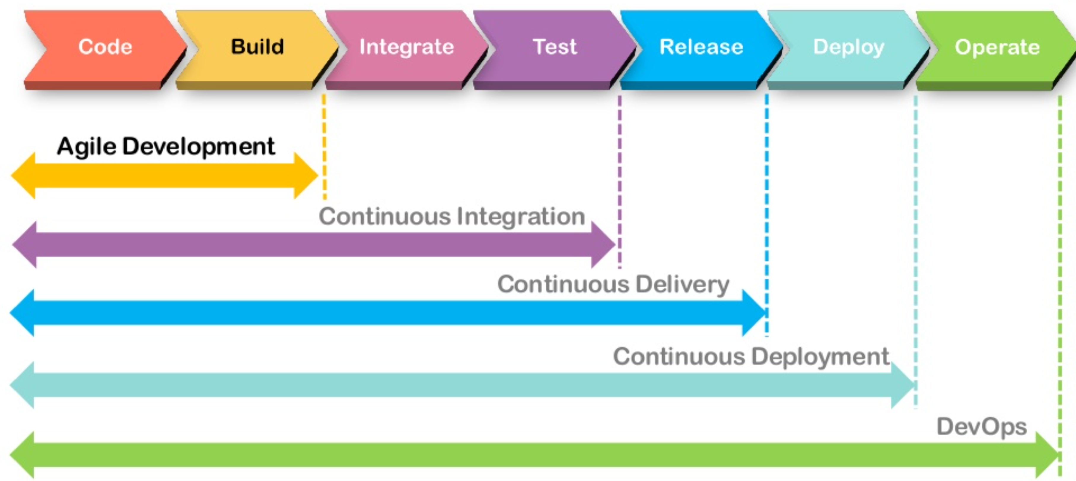

Slide 19
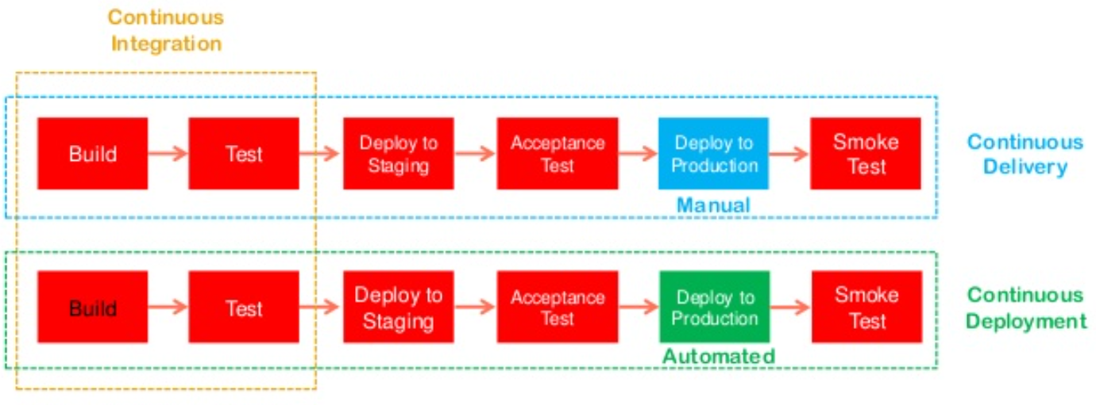

Slide 20
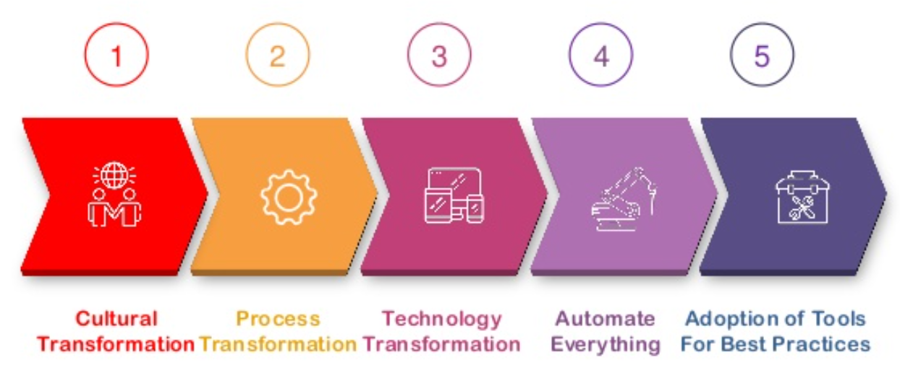

Slide 21
ALM framework
Source
Build
Deployment
Application
Operations
Cloud
Test
On-premises
Process tools

Slide 22



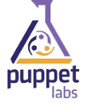












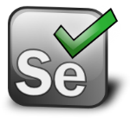



Opensource Ecosystem
Source
Build
Deploy
App
Ops
GitHub
Codeplex
Chef
Puppet Labs
Public Cloud
Jenkins
Hudson
Microsoft Azure
Alerting
Configuration
Grunt
Gradle
Jenkins
Hudson
Linux
Zabbix
Cacti
On-premises
Monitor
Test
Gradle
Vagrant
Travis
Fog
Grunt
Visual Studio
Puppet Labs
Eclipse
Selenium
Process tools
Redmine
JIRA
Notes:
http://www.redmine.org/
https://www.atlassian.com/software/jira/

Slide 23




Microsoft Ecosystem
Repository
Build
Deploy
App
Ops
Release Management for Visual Studio
Microsoft Azure
Visual Studio Online Application Insights
Team Foundation Server
Containers
Team Foundation Server
Docker
ONE CONSISTENT PLATFORM
ON-PREMISES
SERVICE PROVIDER
OR
Release Management for Visual Studio
Nano Servers
TFVC
GIT
Automation Service
Azure Operations Management suite
(OMS)
DSC
Test
System Center
PowerShell
Operations Manager
Team Foundation Server
Microsoft Test Manager
Microsoft Monitoring Agent
xPlat CLI
Resource Groups
Process tools
Release Management for Visual Studio
Service Manager

Slide 24
Key takeaways
Get engaged in the DevOps conversation
Understand products and directions related to DevOps
Leverage additional resources to learn more

Slide 25
Thank you

